Slide 1
Project Setup Instructions
CSCI 3155

Slide 2
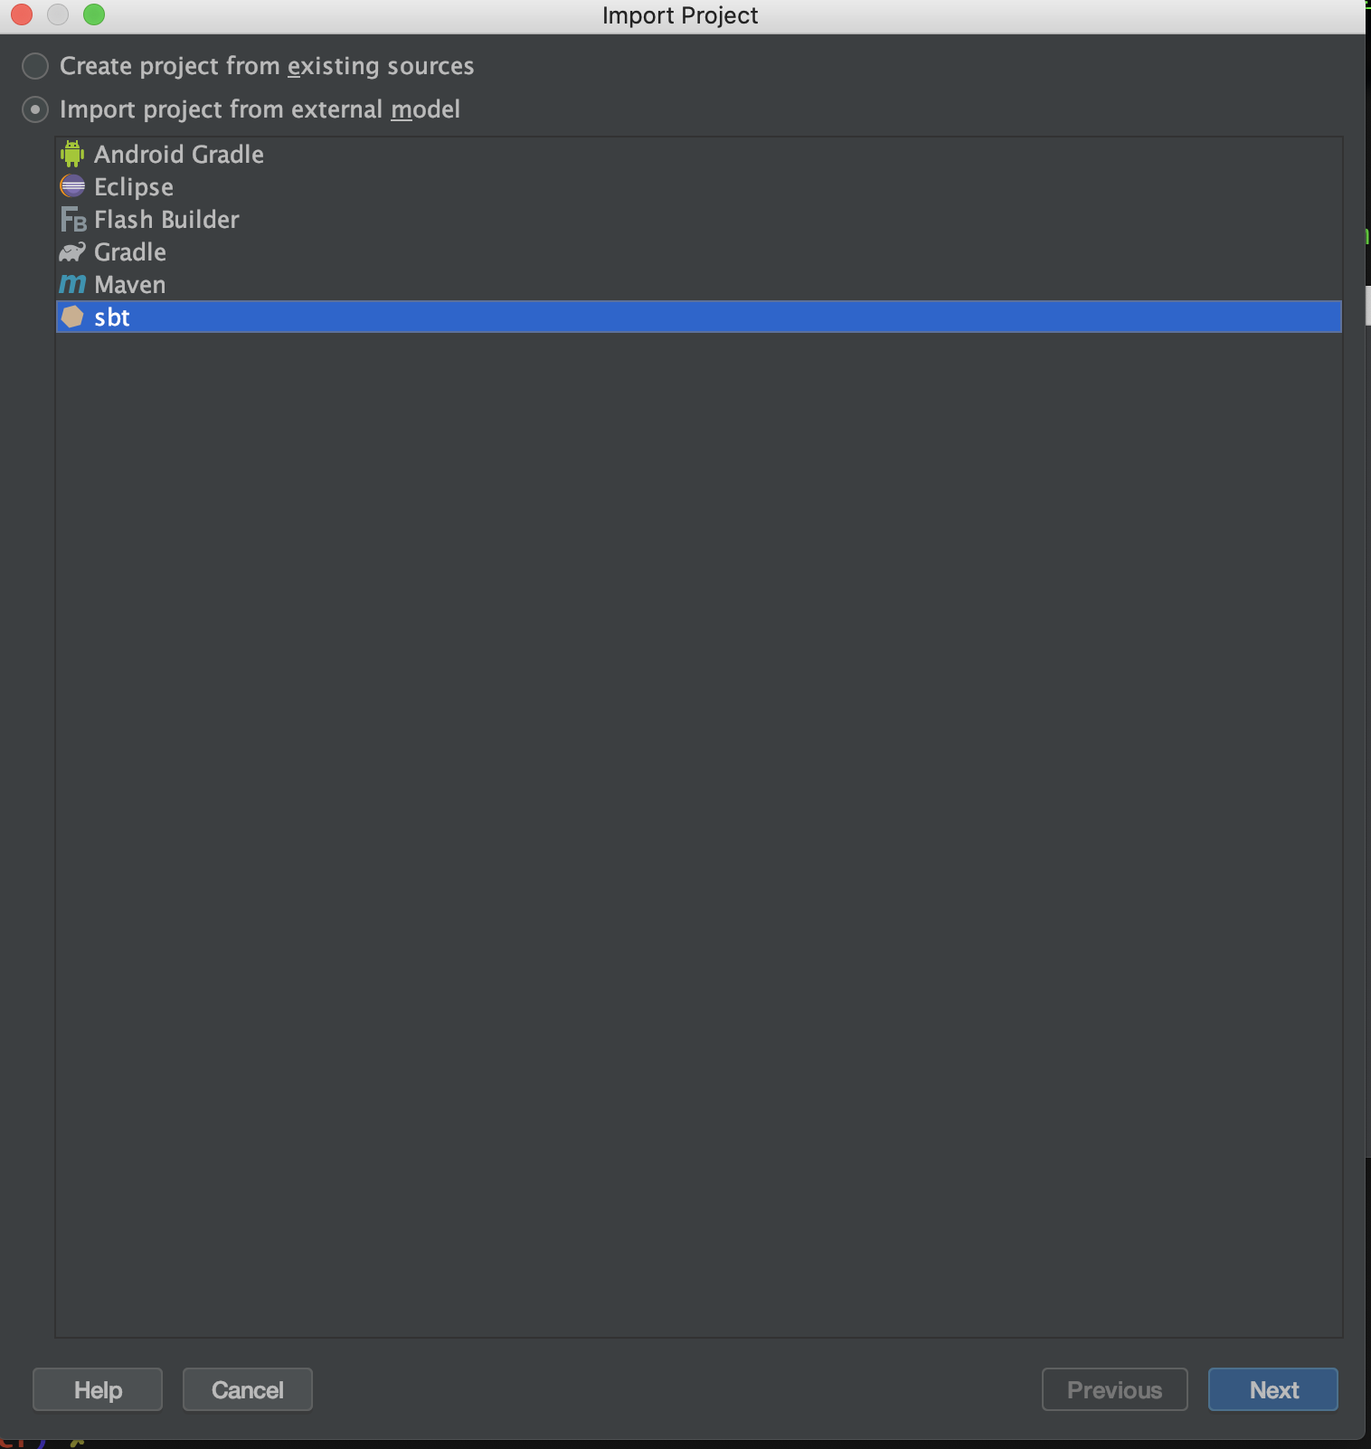
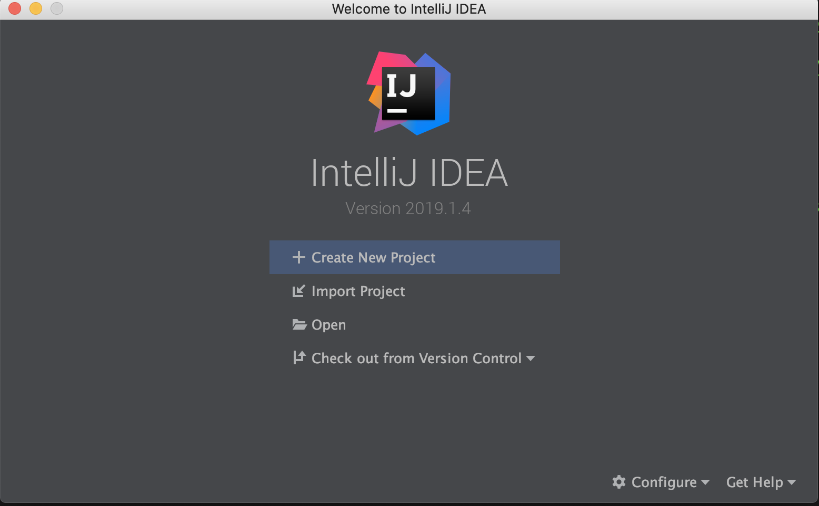
Steps
Download and unzip the project file.
Install IntelliJ IDEA: get the full version by signing up with your CU Boulder email for an academic license.
Choose “SBT”
Choose “Import Project”

Slide 3
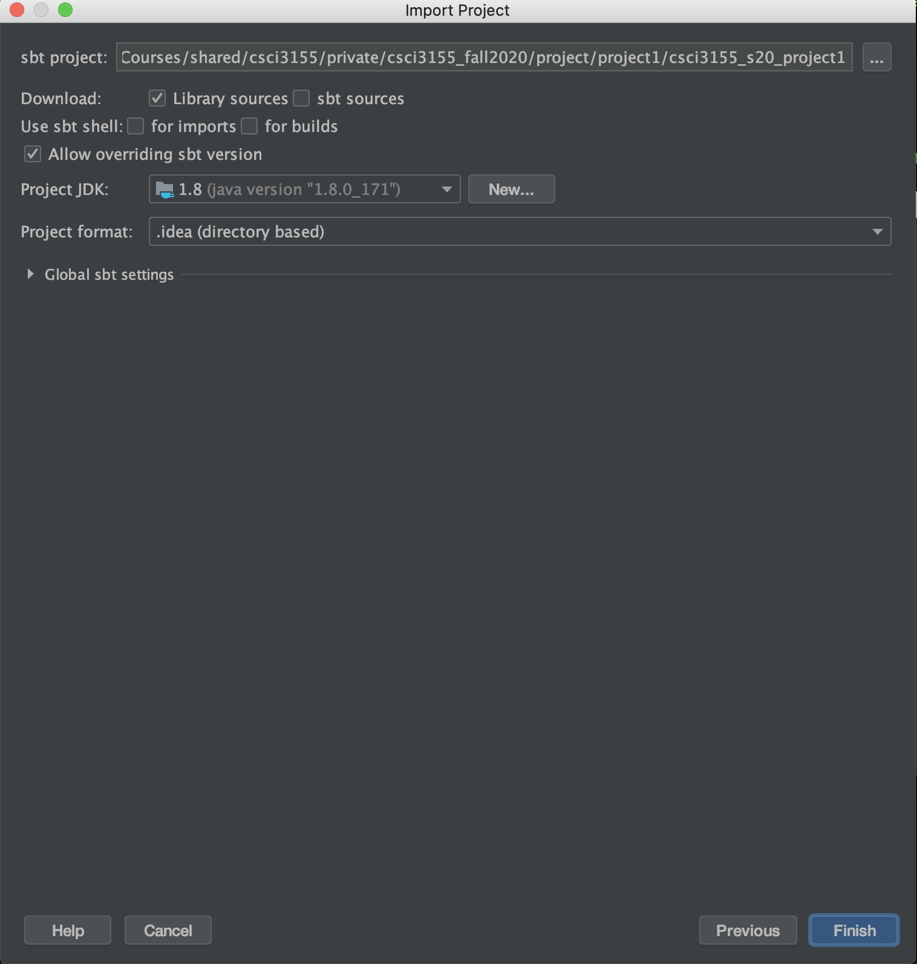
Press here
to navigate
to the root
directory of
the project
after unzipping it
Not sure if Java 1.8
is absolutely
needed but note
that I am using Java 1.8 in my
machine.

Slide 4
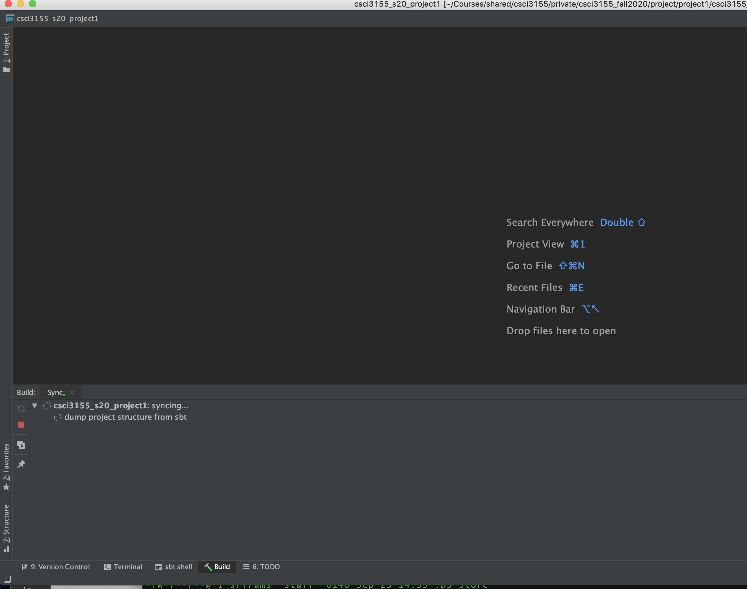
Click here to expand project directories etc.. if not already expanded for you
Wait a few minutes for this to happen
Click on the tiny SBT shell tab at the bottom

Slide 5
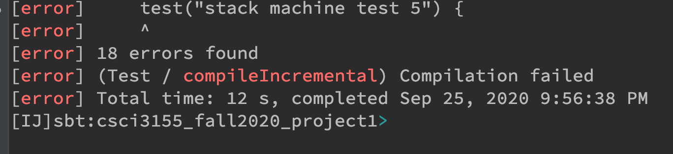
Once you are in the “SBT Shell”: there will be a prompt after some time of setup.
Type “test” on the prompt
> test
You will see a bunch of errors and
then a message saying
18 errors found.
This is because nothing is implemented yet.

Slide 6
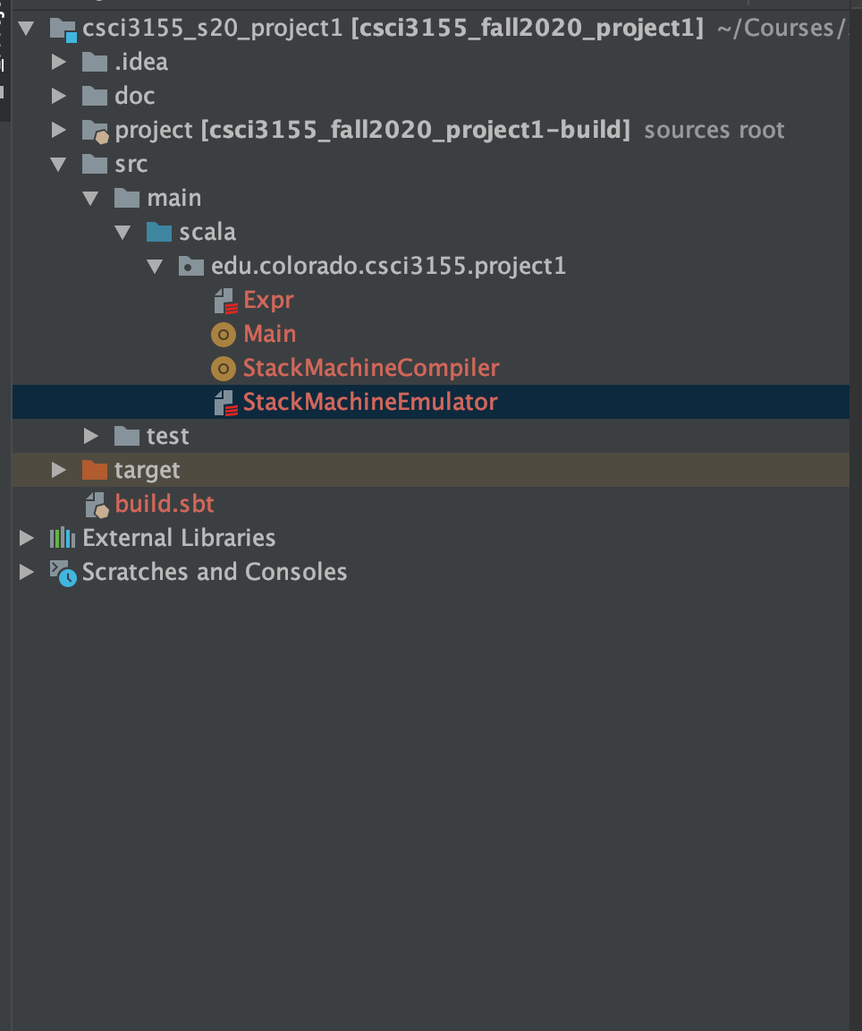
Scala Code Layout
Expr.scala Definition of Expr AST
Main.scala Can be ignored for now
Part 2 of the project: Compile into Stack Machine Instr.
Part 1 of the project: Emulate Stack Machine

Slide 7
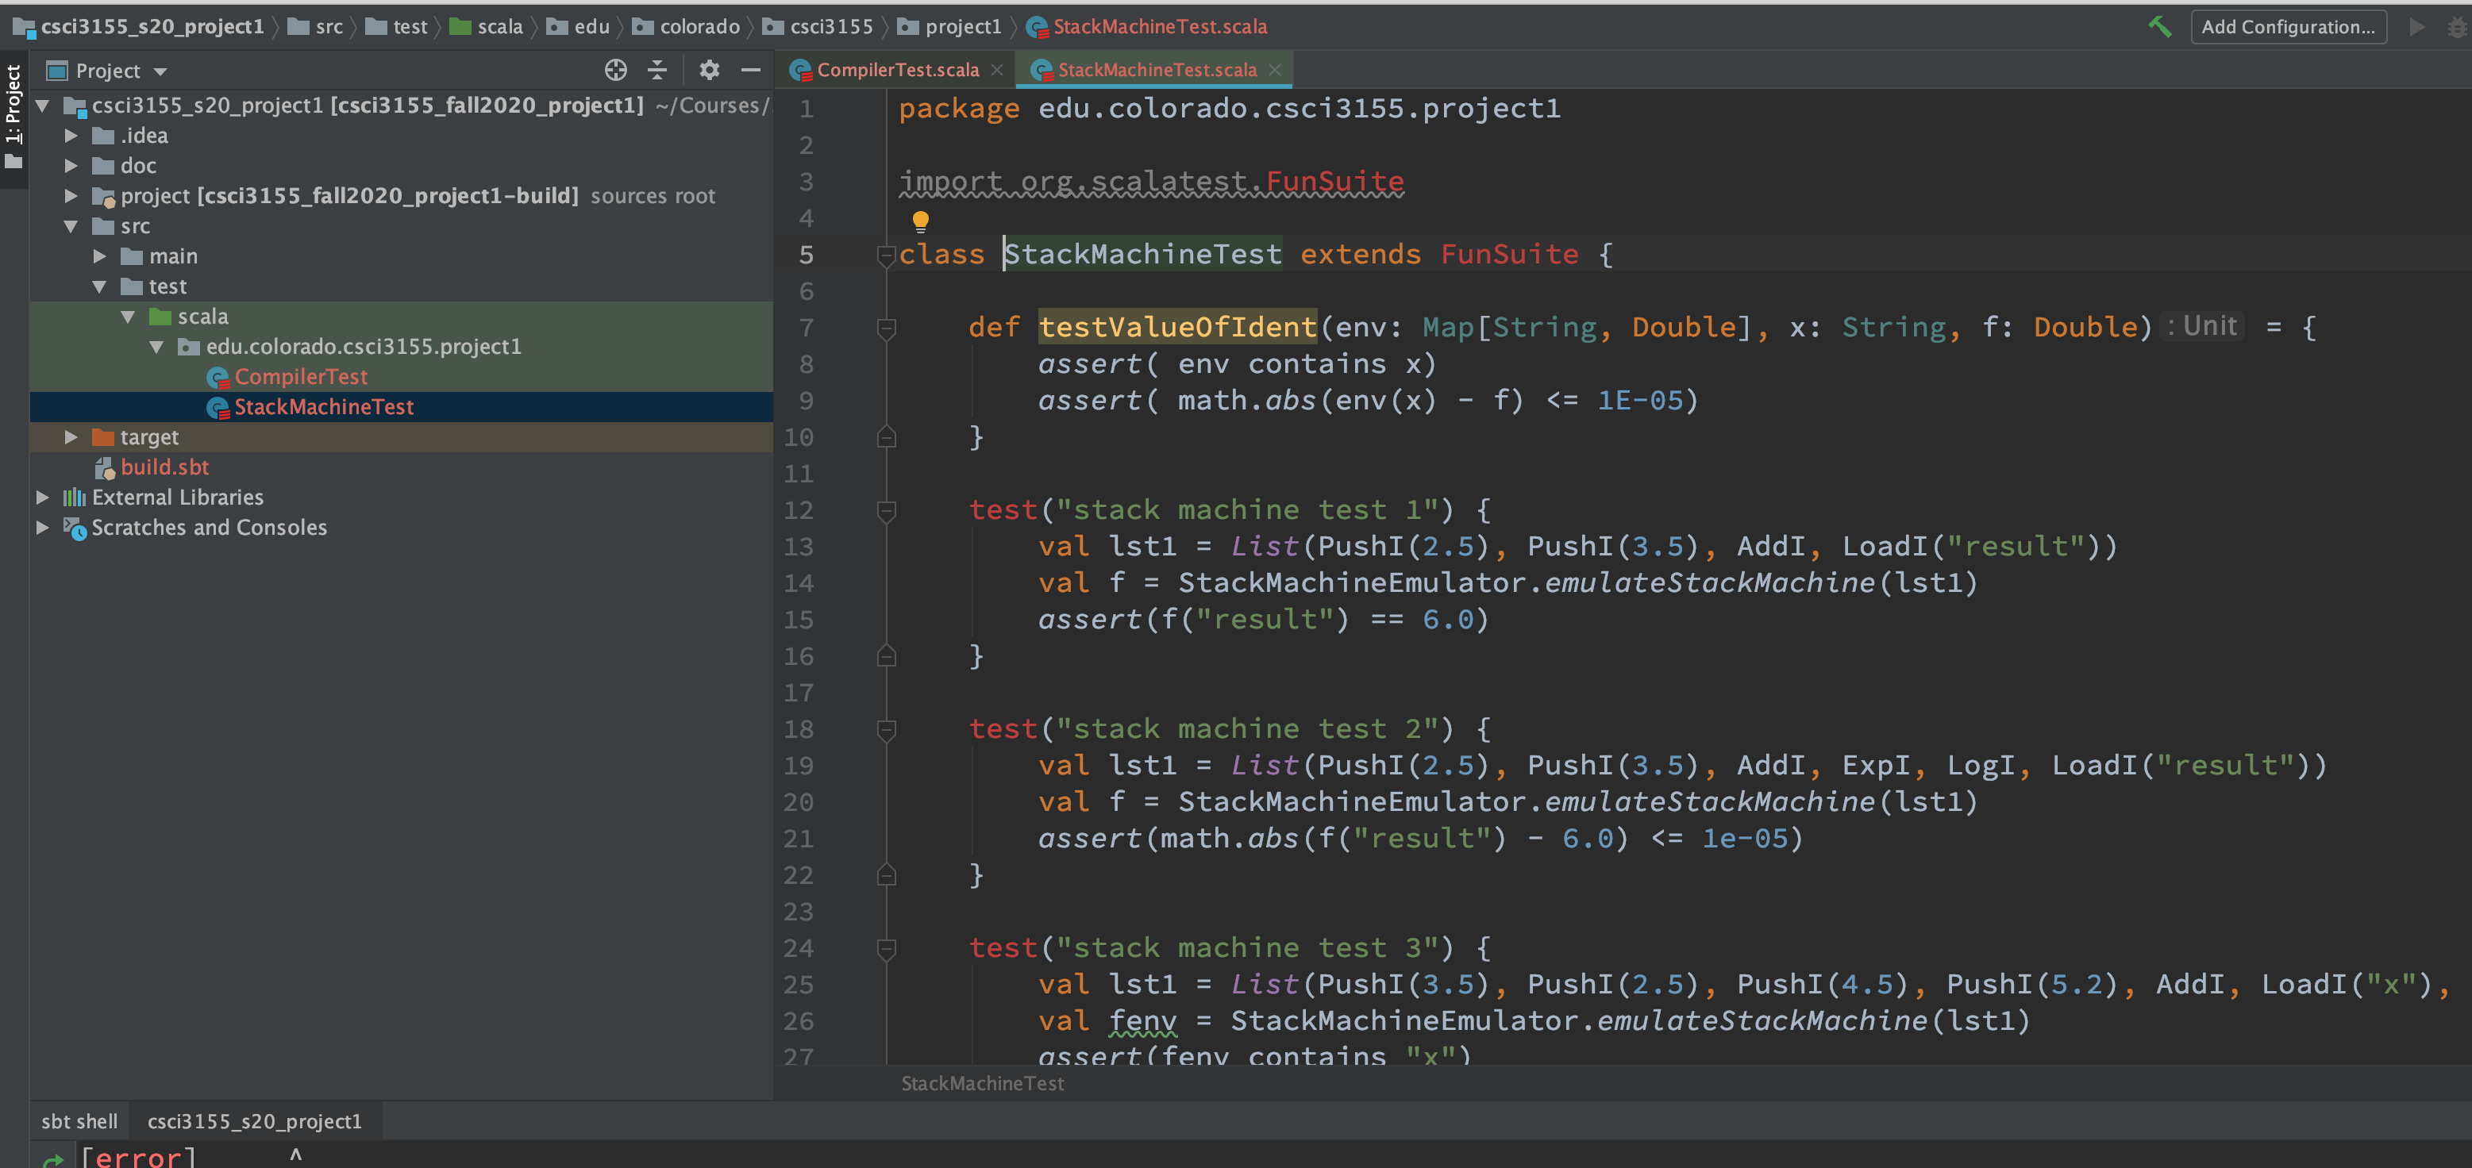
Test Cases Layout
See where the test cases are in the directory
structure. These are the tests that sbt test
runs for you.

Slide 8
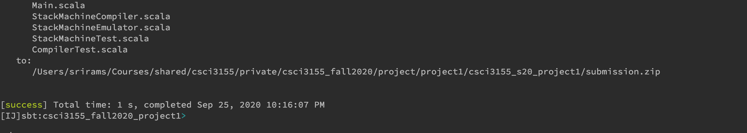
Submission
When you are all done – you will get all test passed message when you type “test” on SBT shell prompt.
Type “checkAndZipSubmission” on SBT shell prompt.
Script Creates a file called submission.zip and
prints out where it has been placed. Submit this zip file.

